Slide 1

Student Alcohol Consumption Data Science Project
Olufemi George

Slide 2
This data approach student achievement in secondary education of two Portuguese schools. The data attributes include student grades, demographic, social and school related features) and it was collected by using school reports and questionnaires. The goal is to determine the correlation (if any) between alcohol consumption by students and their grades in school. We will also be looking at the importance/relevance of other variables in determining grades in this dataset.
Project Overview
Notes:
This is the question that your experiment answers

Slide 3
The Data
The data attributes include student grades, demographic, social and school related features)
Collected by using school reports and questionnaires.
Two datasets are provided regarding the performance in two distinct subjects: Mathematics (mat) and Portuguese language (por).
Both Datasets were merged and we ended up with 959 Observations and 33 variables.
17% of our data contains students that failed. This is an important step because if the proportion was smaller than 15%, it would be considered a rare event and would be more challenging to model.

Slide 4
Issues with Data
Created a passing grade column (0,1) to depict if the student had passed or failed.
17% of our data contains students that failed. This is an important step because if the proportion was smaller than 15%, it would be considered a rare event and would be more challenging to model.
Notes:
Summarize your research in three to five points.

Slide 5
Target Variable
There were 3 grades G1,G2, and G3 representing first, second and final grades respectively.
For this experiment, I‘ll be using the final Grade (G3) and will determine the impact of alcohol usage on Final Grade scores.
I also created a pass/fail variable to use in variable importance.
Notes:
Summarize your research in three to five points.

Slide 6
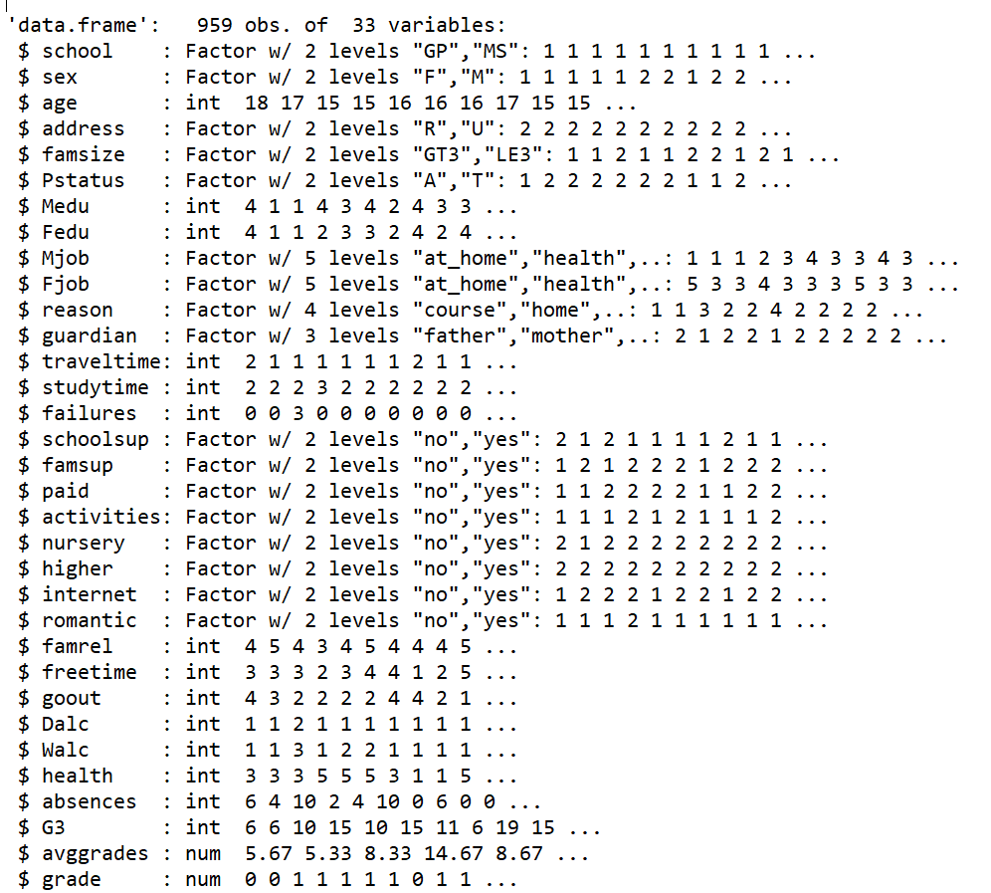
Example Data
Notes:
Summarize your research in three to five points.

Slide 7
Exploratory Data Analysis
No missing values and data from both files had to be merged on common fields.
Used ggplot2 and plot (stats) to examine central tendency and distribution of continuous variables (G3).
Each category was converted into a separate binary variable with a value of either 1 or 0. This increased the number of variables from 33 to 42.
Notes:
Summarize your research in three to five points.

Slide 8
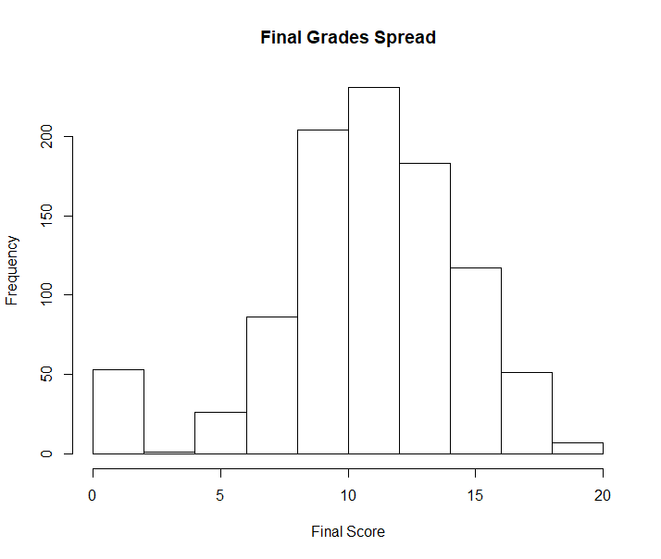
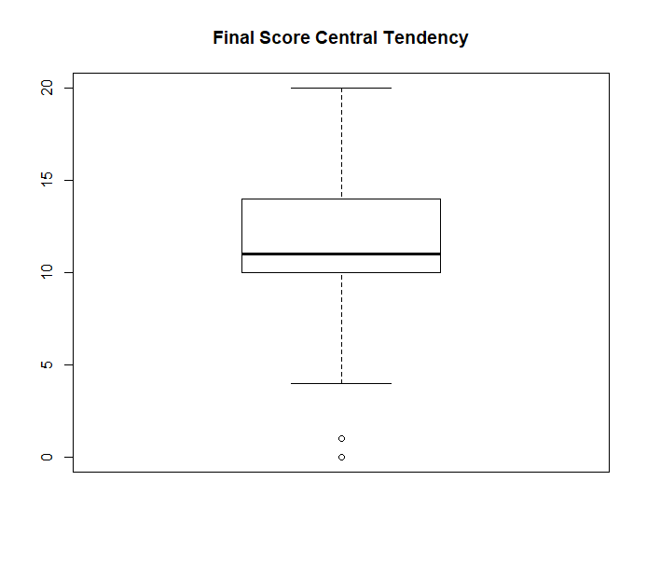
Exploring Final Score (G3)
Notes:
Summarize your research in three to five points.

Slide 9
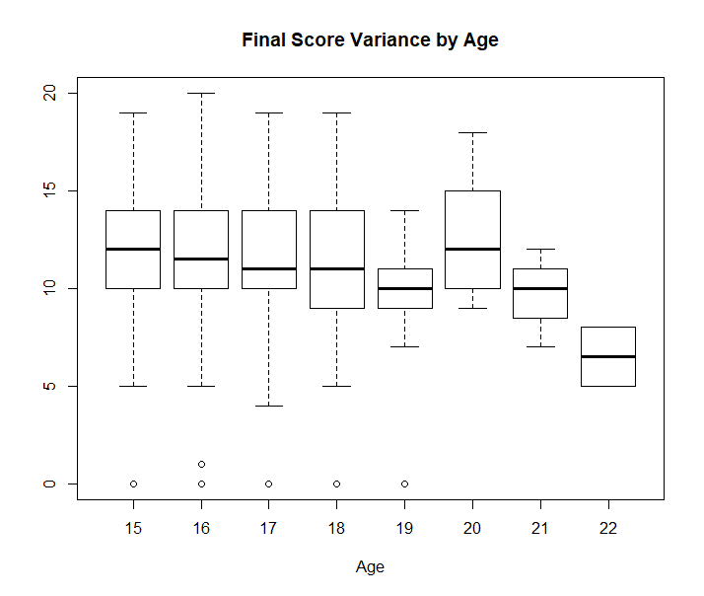
Age
The average final score and spread are relatively constant across the different ages between 15-19
The spread of scores of students who are 19 were was smaller than average and from 19 years, there was a slight decline in average final scores.
This could be due to other factors related to age eg romantic relationships, alcohol etc
Notes:
Summarize your research in three to five points.

Slide 10
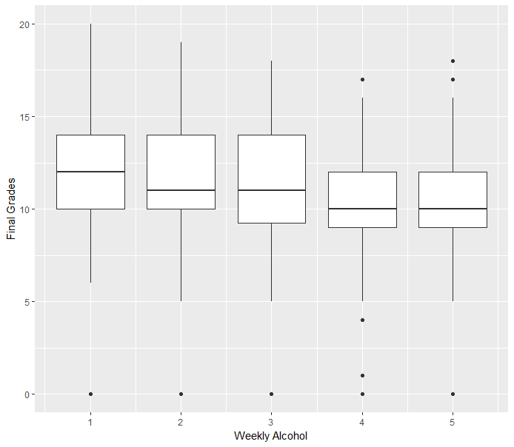
Alcohol Consumption and Final Grades
Notes:
Summarize your research in three to five points.

Slide 11
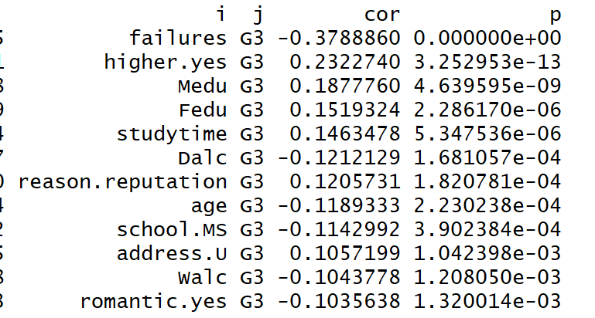
Variable Significance by Correlation
Used functions developed by Stephen Turner.
cor.prob will create a correlation matrix along with p-values and flattenSquareMatrix flattened all the combinations from the square matrix into a data frame of 4 columns made up of row names, column names, the correlation value and the p-value
Notes:
Summarize your research in three to five points.

Slide 12
Model choice considerations
Used functions developed by Stephen Turner.
cor.prob will create a correlation matrix along with p-values and flattenSquareMatrix flattened all the combinations from the square matrix into a data frame of 4 columns made up of row names, column names, the correlation value and the p-value
Notes:
Summarize your research in three to five points.

Slide 13
Model Accuracy
Used functions developed by Stephen Turner.
cor.prob will create a correlation matrix along with p-values and flattenSquareMatrix flattened all the combinations from the square matrix into a data frame of 4 columns made up of row names, column names, the correlation value and the p-value
Notes:
Summarize your research in three to five points.

Slide 14
Add your answer / solution here
Hypothesis
Notes:
Establish hypothesis before you begin the experiment. This should be your best educated guess based on your research.

Slide 15
Dummy Variables
Step 1
Describe this step in your experiment
Step 2
Describe this step in your experiment
Step 3
Describe this step in your experiment
Step 4
Describe this step in your experiment
Notes:
List all of the steps used in completing your experiment.
Remember to number your steps.

Slide 16
Variables
Controlled variables
Independent variable
Dependent variable
These are kept the same throughout your experiments
The one variable you purposely change and test
The measure of change observed because of independent variable
Decide how you will measure the change

Slide 17
Analysis
Hypothesis
Notes:
Establish hypothesis before you begin the experiment. This should be your best educated guess based on your research.

Slide 18
Analysis
First research point
Second research point
Third research point
Notes:
Summarize your research in three to five points.

Slide 19
Feature Importance
First research point
Second research point
Third research point
Notes:
Summarize your research in three to five points.

Slide 20
Conclusion
Brief summary of what you discovered based on results
Indicate and explain whether or not the data supports your hypothesis

Slide 21
Materials
Materials (detailed list) | Quantity (be specific)
Item | Amount
Item | Amount
Item | Amount
Item | Amount
Item | Amount
Item | Amount
Item | Amount

Slide 22
Procedure
Step 1
Describe this step in your experiment
Step 2
Describe this step in your experiment
Step 3
Describe this step in your experiment
Step 4
Describe this step in your experiment
Notes:
List all of the steps used in completing your experiment.
Remember to number your steps.

Slide 23
Data/Observations
Include Observation based on the data from your experiments

Slide 24
Works Cited
Include print and electronic sources in alphabetical order
http://archive.ics.uci.edu/ml/datasets/student+performance

